Slide 1
How do we use polynomials and like terms in architecture?
A presentation by Luca and alivia
Notes:
A- For our presentation, the question we chose was ‘how do we use polynomials and like terms in architecture’.

Slide 2
7x^4+3x+2x
EXPONENT
VARIABLE
Coefficient

Slide 3
Inquiry question
Reasons we chose Architecture
Notes:
L- I am very interested in architecture, and I thought it would be a good way to integrate my interests into a math project.

Slide 4
Architecture & mathematics
Notes:
A- Mathematics are a big part of architecture. From buying supplies, to cutting and measuring materials. For our project, we chose to focus on floor plans.

Slide 5
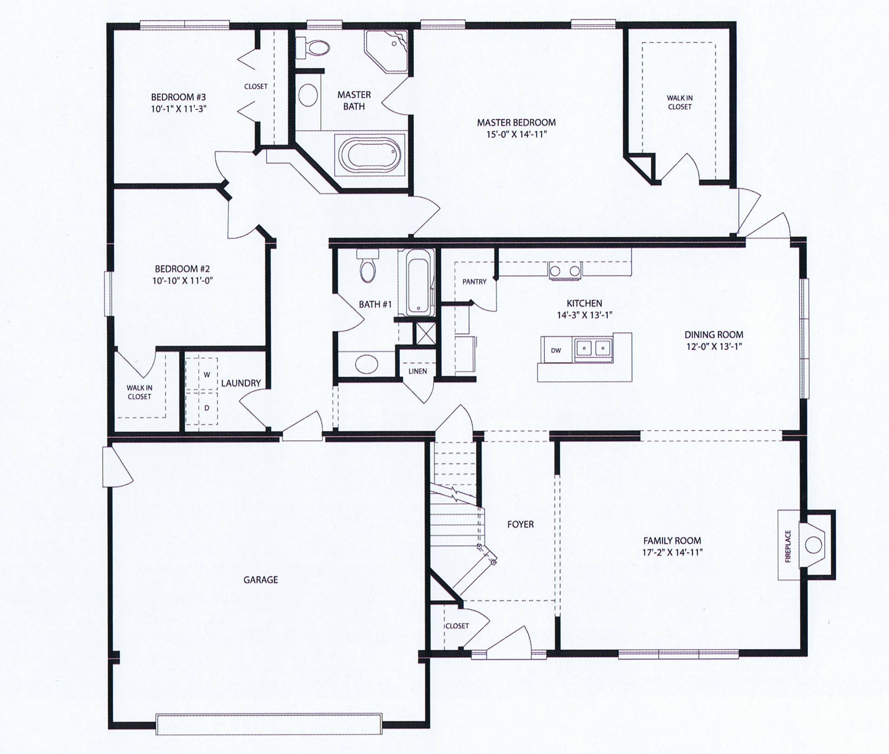
What is a floor plan
Notes:
A- So, in a floor plan, they use like terms to calculate the perimeter and area of a building. In a non-rectangular shaped room, they need to use like terms for the perimeter.
L- We have a few examples of floor plans. They all use polynomials in their calculations.

Slide 6
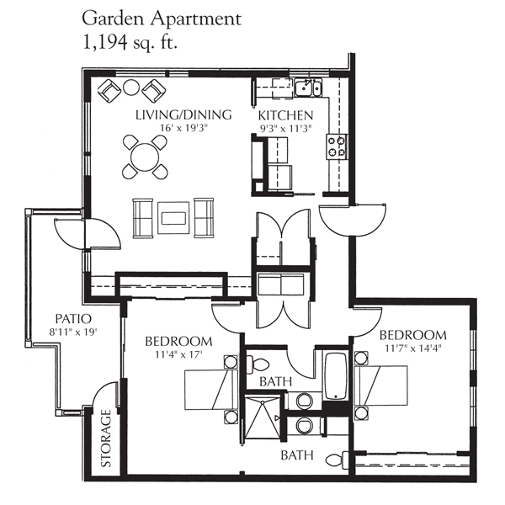
Conclusion:

Slide 7
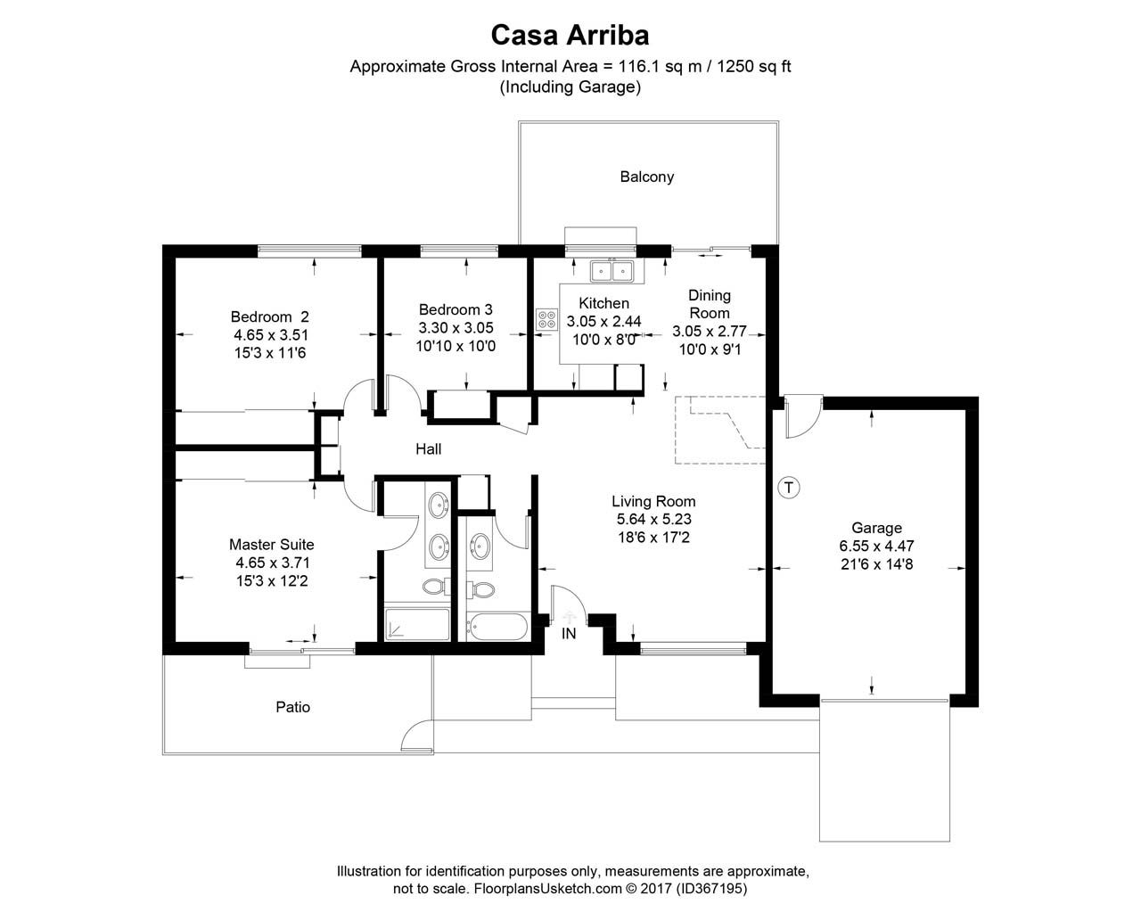
Conclusion:

Slide 8
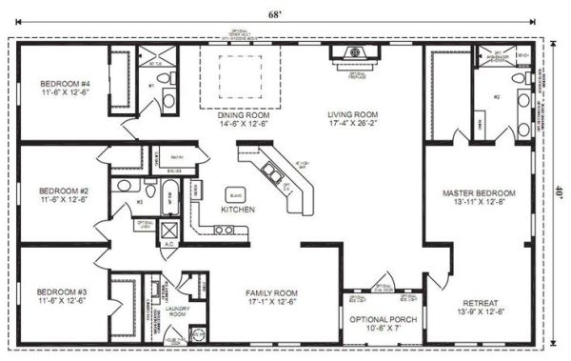
Conclusion:

Slide 9
Are polynomials used in architecture?
Notes:
A- As you can see, we have lots of evidence to suggest that polynomials and like terms are used in architecture. But to prove our theory even more, we have an experiment for you.
L- I am going to AirDrop you an image of a floor plan. Calculate the perimeter, and the first person to come up with the area of the shape, wins!
(Wait for everyone to finish)
A- Correct, the area of the shape is 315cm^2.
L- You all just used like terms and polynomials to solve that!
A- So in conclusion, polynomials and like terms are used a lot in architecture.

