Slide 1
Changing Results for Young Readers
Notes:
Anne Lawson
1 minute
Welcome to Session 2 CR4YR
Heather or ? FN protocol

Slide 2
CR4YR
Touch Back from Session #1
Learner Engagement
Regulated Reader
Aboriginal Principles of Learning
Inquiry Process
Collaboration
Notes:
Anne Lawson
1 minute

Slide 3
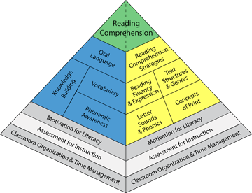
CR4YR Session #2
Role of Oral Language
Phonemic Development
Phonics
Concepts of Print
Sight Word Reading
Automaticity
Notes:
Anne Lawson
Building on the foundation of reading - this session is the first of two explorations of the core components of reading.

Slide 4
Big Ideas
By expanding one’s knowledge of the reading process in all its complexity, teachers can increase their impact on children who struggle to read.
We can deepen our learning through reflecting on our practice and talking with colleagues.
Notes:
Anne Lawson –
1 minute

Slide 5
Learning Targets
By the end of this session, I will understand that reading is developmental and that struggling readers require explicit teaching of the core components of reading.
By the end of this session, I will leave with a question about teaching practice in reading.
Notes:
Anne Lawson Specifically….
Role of Oral Language
Phonemic Development
Phonics
Concepts of Print
Sight Word Reading
Automaticity
1 minute

Slide 6
Questions to Consider… Give One, Take One
What do you do to support your struggling readers?
What activity, strategy, or approach do you hear that you might try in your own classroom?
Notes:
Anne Lawson
15 minutes
Milling to music. Background music. From Writing 44 ( French / English )
Hand out with pyramid as visual prompt

Slide 7
How Reading Works
Struggling readers are not doing the kinds of thinking that proficient readers do in their heads (constructing meaning from texts, solving problems when stuck, fixing mistakes–regulated readers)
Takes time, explicit instruction, and practice
Follows a general developmental pattern
Notes:
Anne Lawson

Slide 8
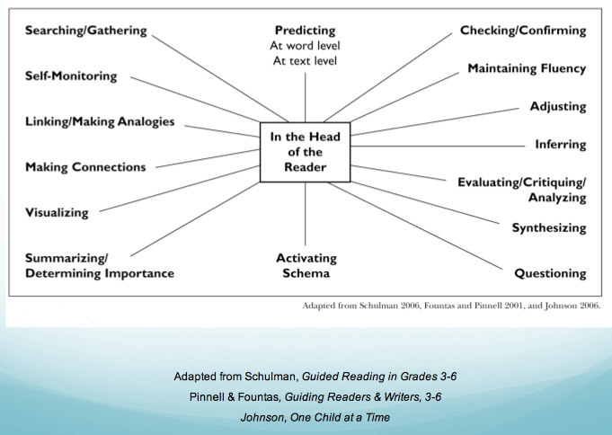
Notes:
Anne Lawson
3 minutes
Conceptual map found in Catching Readers
Reading is complex. This is what happens in the head of a good reader
Struggling readers DON’T do:
1. check on themselves and think about what they are reading 2. notice when their reading doesn't sound right, look right, make sense Insert a slide showing three questions CTs should be constantly asking and teaching students to ask: Does this look right? Does this sound right? Does that make sense? 3. Stop when something doesn't seem right and take action 4. Use a variety of strategies to 'fix' their reading Struggling readers haven't built an efficient reading process. They wait for someone else to intervene or substitute words that don't make sense, or they just do nothing. Struggling readers need to know they can develop strategies for solving the glitches they encounter as they read. If these pieces are missing for our struggling readers, what are YOU doing to support these skills with your students?

Slide 9
Three Questions to Ask
Does this sound right?
Does this look right?
Does this make sense?
Notes:
Meta cognitive strategies (Slide added)

Slide 10
Foundations of Reading
oral language
phonemes
phonics
Concepts of print
sight words
automaticity / fluency
Notes:
Anne Lawson
1 minute
Metaphor – bridge
Reading components are like nuts and bolts. They combine together to develop a strong and capable reader.
They unfold developmentally, but also intertwine.
We will look at each component.
Handbook for notes, ideas, inquiry.

Slide 11
The Inquiry Process
Focusing
Scanning
What does our focus need to be?
What’s going on for our learners?
Developing a Hunch
What is leading to this situation?
Checking
Learning
Have we made enough of a difference?
How and where can we learn more about what to do?
Taking Action
What will we do differently?
Notes:
The point of this session is not to give an in depth workshop on each of the foundations for learning. It is to review the core components, ask questions, reflect upon and refine our own practice in these areas (from the lens of supporting struggling readers).

Slide 12
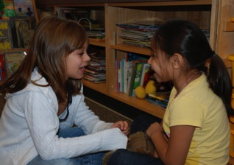
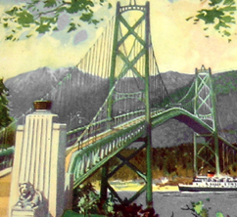
Oral Language: Foundation for Literacy Development
“Oral language is the foundation of literacy learning and is considered critical for successful literacy development Talk is the bridge that helps students make connections between what they know and what they are coming to know.”
… David Booth
Notes:
Shannon / Doreen (1 min)
Speaking and listening skills are crucial for future reading and writing success. It is through everyday oral experience that children gain the skills they need to become strong readers.
Oral Language opportunities also increase learner engagement

Slide 13
Students use language to monitor and reflect on experiences and to reason, plan, predict and make connections to what they have heard, read, and viewed.
British Columbia English Language Arts IRP
As students speak and listen, they gain new information, connect new ideas with prior knowledge, articulate their thinking and learn to communicate effectively with others.
Oral language helps students build more sophisticated understandings, explore relationships among ideas, and explore questions in their reading and writing
Notes:
Shannon / Doreen (2- 3 min)
1. It is the incidental acquisition (social function, semantics, syntax (grammar) morphology, phonology, pragmatics etc….) that provides exposure to what may come within the world of reading
2. Students who have too little exposure to and development of oral language find learning to read (and write) very difficult
3. Reading comprehension depends on language ability

Slide 14
Literate Conversations
Children need to engage in true literate conversations – “the kind that people outside the classrooms engage in to make meaning of a text they care about.”
Richard Allington,
Educational Leadership, October, 2014
Notes:
Shannon / Doreen (2-3 min)
Oral language experiences contribute to children's language and literacy development. Chief among these oral language experiences are conversations.

Slide 15
In the Classroom…
Social speech – teacher / student interaction
Private speech – student imitated
Inner speech – self talk
Prompt the child to say something about the book.
Evaluate the child's response.
Expand the child's response by rephrasing and adding information to it.
Repeat the prompt to help ensure the child has learned from the expansion.
Notes:
Shannon / Doreen Pg. 44 (CRBTF) Zone of Proximal Development (1-2 min)
Social speech…private speech…inner speech….
Dialogic reading is simply children and adults having an authentic conversation about books.
open-ended questions
expand upon what child says
encourage children to talk more and give descriptions of what they see.
is most effective when a child has at least 50 words of expressive vocabulary.
Dialogic reading has proven to be the greatest approach for making improvement in young children’s language development. It is the back and forth conversation, tied to a “single idea or topic” that makes a difference (National Early Literacy Panel)
Link to: parents helping at home, sitting with student during silent reading ….

Slide 16
Our Turn to Talk An early primary oral language resource
Oral language experiences contribute to children’s literacy development
Expressive and receptive oral language skills need to be taught explicitly
Early identification of language difficulties is crucial.
Early intervention accelerates language learning.
Notes:
Shannon / Doreen (4min)
OTTT is a document that is research based and was written by and for kindergarten teachers in North Vancouver. It is now sold and used throughout British Columbia.
Our kindergarten teachers began noticing a difference in the oral language ability that their students were entering K with and they asked for help with teaching expressive and receptive oral language skills. OTTT was born.
We were thrilled to then see the government come in with the oral language component to the new LA IRP and found that OTTT helped teachers meet nearly all of the required learning outcomes for that portion of the IRP.
Remember, although this was originally designed as a K resources, it is also really important for all teachers of reading to know the foundations of oral language and its connection to reading.
Some great activities and strategies within…. Kinder Teachers have a quick chat at your table about the kinds of strategies you have found in this resource….
90% of all learning takes place in social situations..

Slide 17
Oral Language
Notes:
Shannon / Doreen
(10 min max)
Examples:
The first picture shows a young boy telling his story through the use of a “television prop” (Shannon – grade 2s in Australia during “free play)
The second is a picture of “story bags” You have a similar activity on your table. Take a few minutes to look at the pictures in your “story bag/envelope” Choose several pictures and use them to tell a story to the person next to you or to your table. Listeners can/should ask questions about the story once the speaker or story teller is done. How did this activity go? How can it be adapted for your students?
Story Stones – rocks with pictures on them….
Imagination Basket ….. A basket full of artifacts
Artifacts – for discussion
Barrier activity – How to put on a “button up shirt”…. If time…

Slide 18
Setting the Stage for Good Speakers & Listeners
Strategies for Teaching Reading: Thinking Partners:
http://www.youtube.com/watch?v=qYoeVkf3s7E&feature=related
What effective teaching strategies did you notice in this video? (table group discussion – 2 min.)
Notes:
Shannon / Doreen (4 min)
Watch video to 2:15 only
Report Out: Look for – Gradual Release of Responsibility, modeling, formative feedback, modeling self-regulated learning, honouring the value of oral language, accessing prior knowledge

Slide 19
Brain and Body Break

Slide 20
Phonological Awareness vs. Phonemic Awareness
What’s the difference?
In what grades do we teach these skills?
Take 5 minutes in your table group.
Notes:
Janet

Slide 21
Phonological Awareness
The conscious awareness of speech sounds in language.
Words
rhyme
Syllables
Onset/rime
Notes:
Janet
There are two parts to processing sound.
Phonological awareness is the large umbrella.

Slide 22
Phonemic Awareness
Awareness of sounds in words (e.g. ability to segment/manipulate sounds (phonemes) within words.
Sound (phoneme) discrimination
Phoneme deletion
Phoneme manipulation
Phoneme segmentation of words to sounds

Slide 23
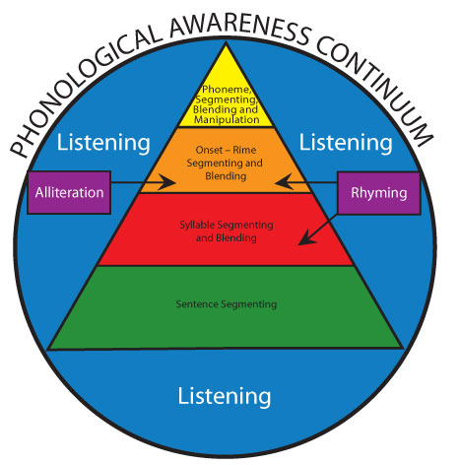
Notes:
Talk about the research – struggling readers have holes in their phonological/phonemic awareness skills.
Research shows that many struggling readers have difficulty acquiring and solidifying phonological awareness skills. We need to meet them where they are at no matter what grade so there is no set answer to “When do we teach these skills.” Although they are thought of as being taught in Pre-K-K-1, we need to find ways to continue phonological awareness instruction with struggling readers to patch holes they may have in this foundation skill.

Slide 24
Phonological Inventory
Select a struggling reader in your class
Complete the Phonological Inventory
Record your thinking on the Student Case Study – Follow up #2
Bring your results back next week
Notes:
Janet – hand out phonological awareness inventory pg. 67
The TOPA is a great Kindergarten screener – but Inventories/assessments such as this are better for helping us to know specifically what skills in the phonological awareness continuum to target with various students (no matter what grade they are in).

Slide 25
Notes:
Great for remembering that with phonological and phonemic awareness students should not be looking at letters. At minimum they might be looking at a picture.

Slide 26
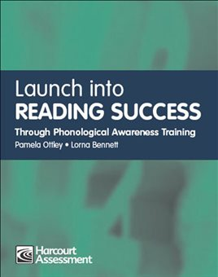
Phonological Awareness Resources
Notes:
Great resources for activities that can be done with students who need targeted skills in this area. Depending on what primary grade(s) you have been teaching you may be more or less familiar with these resources.
Firm Foundations is available online in the portal and has tons of great activities.

Slide 27
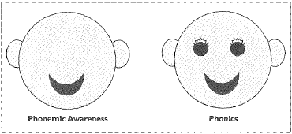
Phonics vs. Phonological/Phonemic Awareness
Phonics = letter/sound correspondence
Phonology = processing sounds that you hear (no letters)
Notes:
Refer to handout of faces with eyes/no eyes

Slide 28
Something to think about …
Approximately two years of phonics instruction is sufficient for most students
Explicit phonics instruction is vital for the 10-20% of students who don’t pick up on phonics without explicit instruction.
Richard Allington
“60% of what teachers are teaching, students already know.”
John Hattie
Which of your students already know what you’re teaching?
Notes:
Phonics instruction is just one piece of your reading program.
The research is showing us these things:
Whole class phonics instruction has a much lower effect size than does targeted phonics instruction for specific students (Hattie). We know that struggling readers require systematic, sequential phonics instruction because they don’t pick this skill up like our proficient readers do.
Hattie’s meta analysis research tells us that 60 percent of what teachers are teacher, students already know.

Slide 29
Teach Phonograms
students require the explicit teaching of phonograms (“letter friends”)
Students need letter sound knowledge to check and confirm words
Teach them in the context of “real reading” rather than in isolation.
Notes:
phonograms, phonics and phonemes are all different - We are not teaching a workshop on phonics
Given the research - What can I let go of in my practice?
Refer to handout – and wall posters
- this knowledge will give your students some real tools to work with—and there will be nothing to unlearn later!
- Talk about Assessment (e.g. CTBS) – to help target phonics instruction. Breaks it down into very specific patterns/skills (e.g. R controlled vowels, silent E etc…)

Slide 30
Reflection…
How can you plan for instruction if you only need to teach phonics to 20% of your students?
Assessments?
Physical layout?
Materials?
Technology?
Centers?
Collaborative staff (EA, LA/ST, FOS, Co-teacher, TL, ABST, …)
Notes:
How are you utilizing the adults in the room or resource people in the school/FOS?
15 minute conversation – and then bring them together and point out resources in Catching Readers Before They Fall that can help assist with organization of literacy instruction.

Slide 31
Resources
Professional Resources about guided reading: (p. 82)
Guided Reading: Making it work (Schulman and Payne, 2000) (p. 82)
Growing Readers: Units of Study in the Primary Classroom (Collins, 2004)
The Daily Five: Fostering Literacy Independence in the elementary grades (Boushey and Moser, 2006)
Literacy Work Stations: Making Centers Work (Diller, 2003)
Professional Resources About Building Your Classroom Community and Physical Space: (p. 94)
Spaces and Places: Designing Classrooms for Literacy (Diller, 2008)
Designs for Living and Learning: Transforming Early Childhood Environments (Curtis and Carter, 2003)
On their side: Helping Children Take Charge of their Learning (Strachota, 1996)

Slide 32
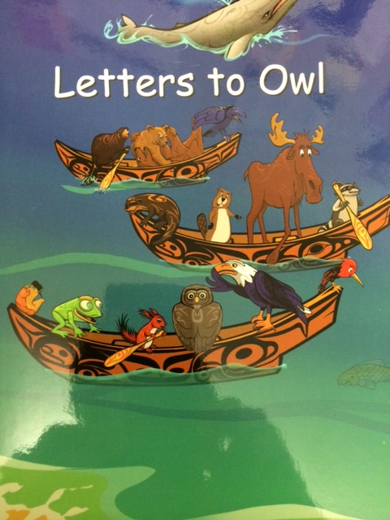
Concepts of Print
print has meaning
print can be used for different purposes
relationship between print and speech
a difference between letters and words
words are separated by spaces
a difference between words and sentences
Notes:
Strong Readers – concept of print Anne
*** add strong nations images from Anne

Slide 33
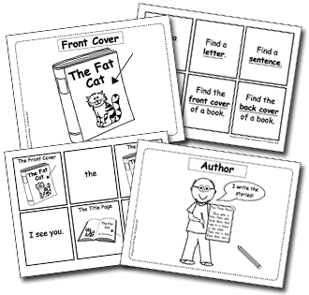
Concepts of Print
There are (punctuation) marks that signal the end of a sentence.
Books have parts such as a front and back cover, title page, and spine.
Stories have a beginning, middle and end.
Text is read from left to right and from top to bottom.
The Book With No Pictures

Slide 34
Concepts of Print: Assessment Ideas
Give the student a book and ask the following questions:
Can you show me:
a letter?
a word?
a sentence?
the end of a sentence (punctuation mark)?
the front of the book?

Slide 35
Concepts of Print: Assessment Ideas
Can you show me
the back of the book?
where I should start reading the story?
a space?
how I should hold the book?
the title of the book?
how many words are in this sentence?
Notes:
Book mark…Anne
Another possible assessment this week with your struggling reader – in the moment, authentic assessment

Slide 36
Sight Words
Dolch list, phrases and puzzles
Fry’s list
word lists
How do you teach sight words?
Which “lists” do you use?
How often do your students practise reading sight words?

Slide 37
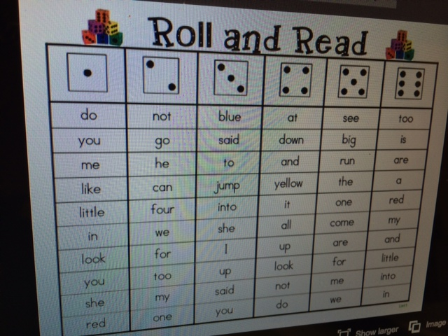
Sight Word Activities
Twister
Roll and read
Bingo
Snap Words
Memory
Around the World
Slap Shot
Notes:
***add pictures from Anne

Slide 38
Automaticity of Skills
Rapid recall of :
letter names
letter sounds
sight words
letter combinations
How do we promote
automaticity?
Notes:
Janet – technology piece? – practice for automaticity
The automaticity of these skills builds fluency in passage reading which supports comprehension
Classroom Suite 4 – Lexia – Apps
Unconscious competence

Slide 39
Technology Supports
iPad/iPod
Jolly Phonics
Hooked on Phonics (classroom edition)
Hairy Letters
Starfall
Reading Intro by Oz Phonics
Computer Based
Classroom Suite 4
Lexia
Starfall
Samson’s Classroom (sight words/spelling)
Notes:
There are many apps out there - be wary of very cheap/free ones as many of them do not allow you to set up multiple users, or track a students progress, and may have haphazard organization.

Slide 40
Session Reflection
How has my understanding of the foundational skills of early reading changed?
What reading foundation would I like to investigate further or strengthen in my classroom?
Notes:
Shannon/Janet/Doreen – Learning Target slide appears again at end of session – Reminder: Collaboration. We are not alone in our pursuit of professional growth. Seek team members.
These are from the learning targets at the beginning of the session
New research forms our practice…we need to reflect on research and bring it into the classroom
Wrap the session up – re word to be softer
an activity, new understanding etc.

Slide 41
Big Ideas… revisit
By expanding one’s knowledge of the reading process in all its complexity, teachers can increase their impact on children who struggle to read.
We can deepen our learning through reflecting on our practice and talking with colleagues.

Slide 42
Learning Targets
By the end of this session, I will understand that reading is developmental and that struggling readers require explicit teaching of the core components of reading.
By the end of this session, I will leave with a question about teaching practice in reading.
Notes:
Revisit Learning Targets for session.
Feedback form
Door Prize

