Slide 1
Field Journal!!!
By Maddie

Slide 2
Asking a question
How do we interact with microorganisms in school?
I think this is an interesting experiment because we can use out natural surroundings to learn and to we can relate our findings, hypothesis and predictions to what we know and understand about our environment.

Slide 3
Making a Hypothesis/Prediction
On this slide, state your hypothesis and your prediction of the experiment. If you need a refresher of what these are, please refer to the learning guide on the Scientific Cycle of Thinking.
Hypothesis - Areas that are more frequently touched will contain more microorganisms then areas that are not.
Prediction - I predict the doorknob contain more microorganisms than the water fountain button.

Slide 4
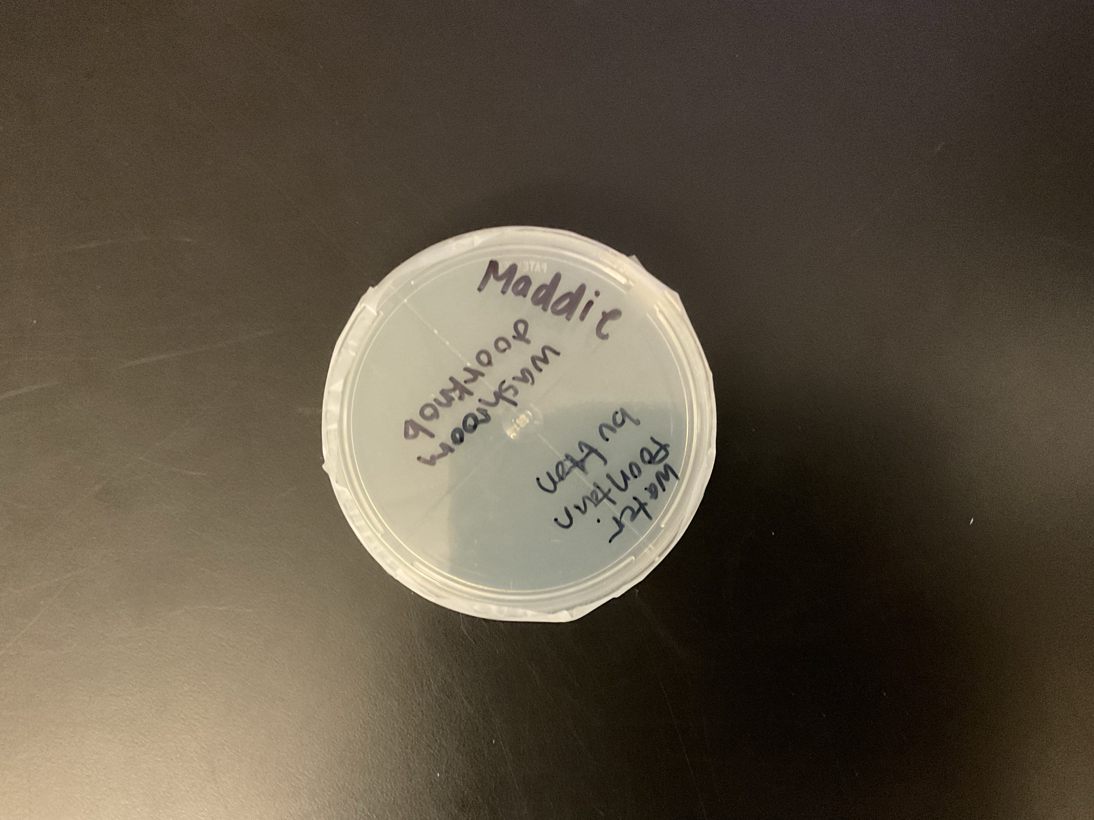
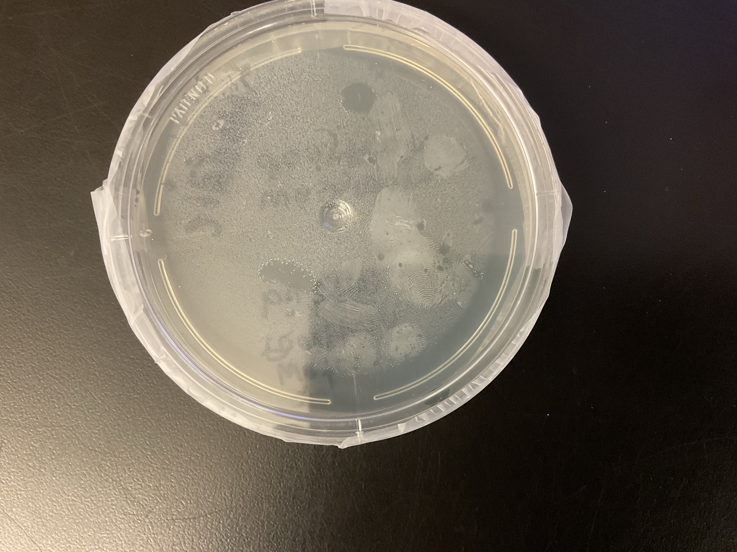
Testing/Checking
Materials: Swabs, Gloves, Goggles, Petri dishes, Agar, Tape
Procedure: We started by putting on the gloves and goggles to create a cleaner environment. Then using the swabs we choose different areas to brush. Then take the brush and swirl it in the agar powder in your Petri dish. Then close the lid and tape it shut so that the bacteria cannot escape. Check back in a couple days to see if it’s matured.

Slide 5
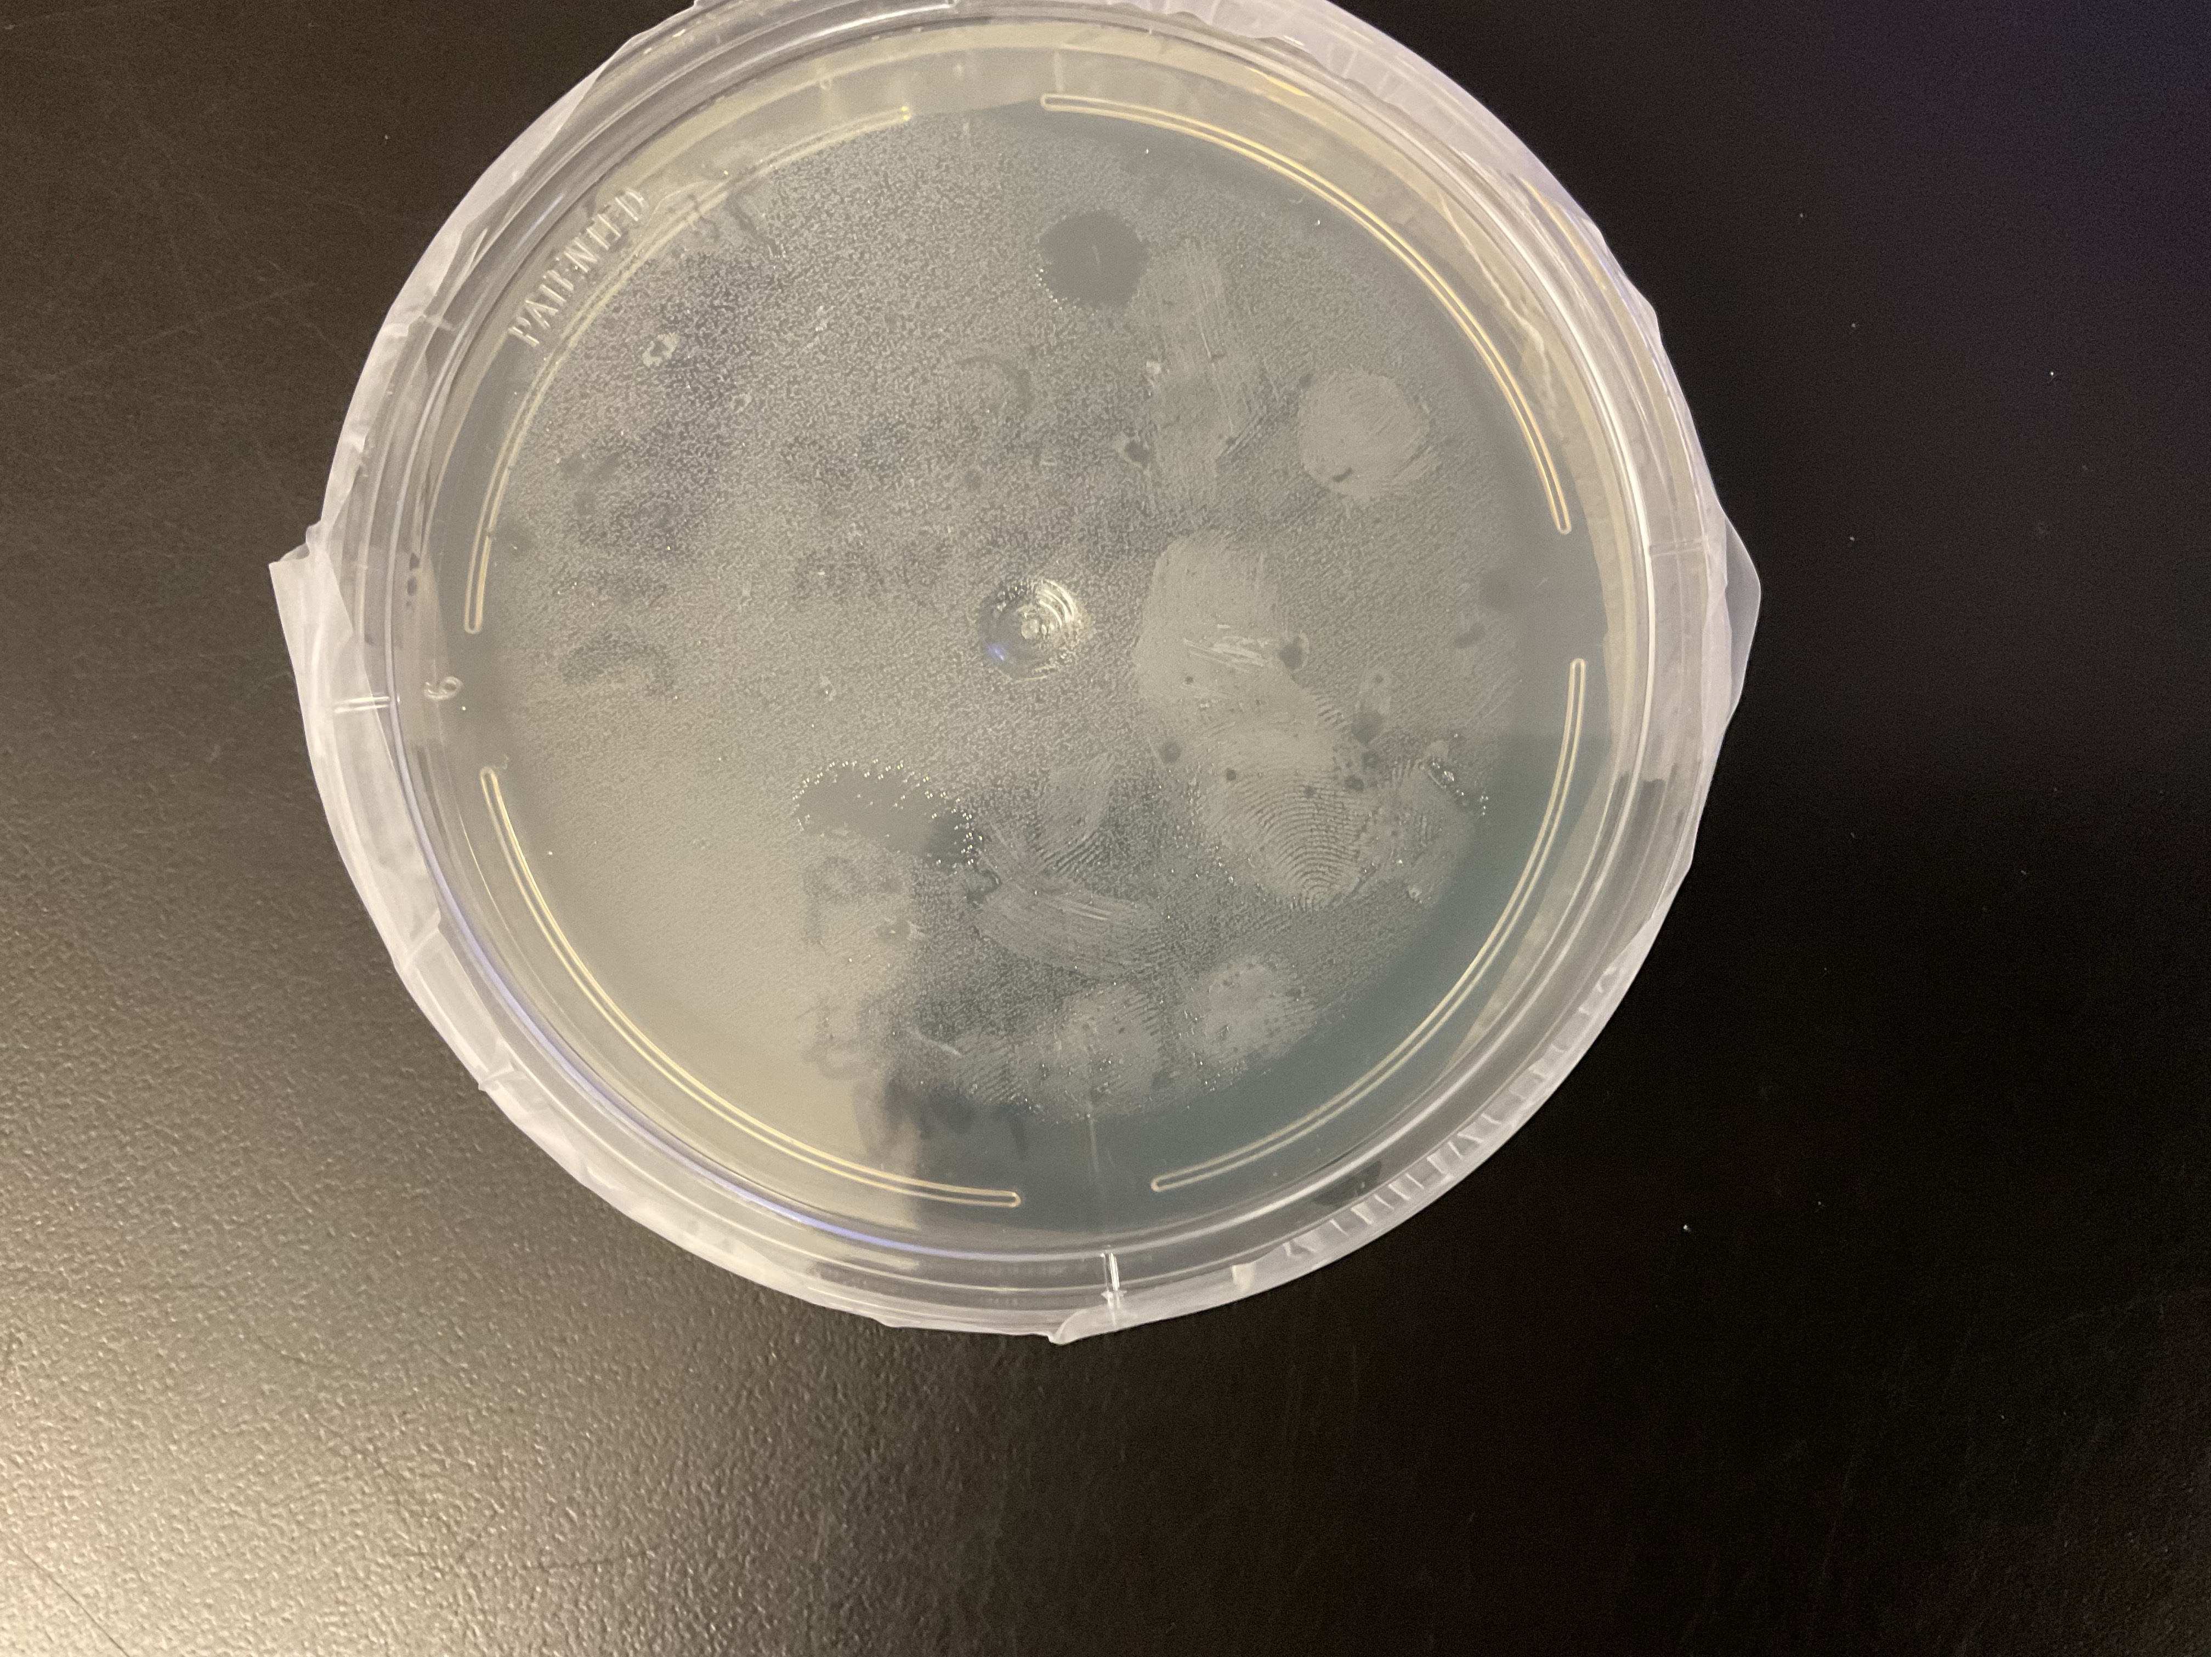
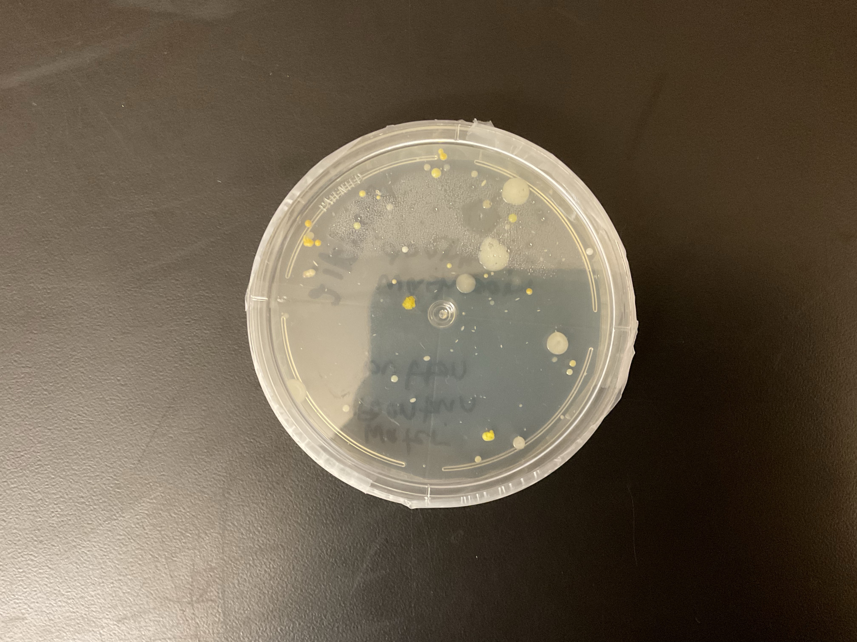
Observations
When I did a first check in of my Petri dish I noticed some small white dots but not a lot. I had colonies of them but nothing was forming into something bigger or interesting.
Fast forward a couple days and you can see drastic changes. The small white dots had grown in size and new,neon shaded dots are popped up and were growing.

Slide 6
Summarize your findings
I think this is an interesting experiment because we can use out natural surroundings to learn and to we can relate our findings, hypothesis and predictions to what we know and understand about our environment.
Using my findings, I noticed how areas that were more often used while out bodies may have passed on or were carrying more bacteria were more contaminated and more likely to pass on the bacteria. I would say that my hypothesis and predictions werecorrect because I’ve noticed how often the doorknobs are touched and that side contained more bacteria then the side that contained the water fountains bacteria.

