Slide 1
GUMMY BEAR DIFFUSION
How do different brands of gummy bears react to normal water, carbonated water and vinegar?

Slide 2
HYPOTHESIS
The brands wont won’t affect the change, the carbonated water will make the gummy bears bubble and dissolve a little bit, and the vinegar will cause the sugar to dissolve.

Slide 3
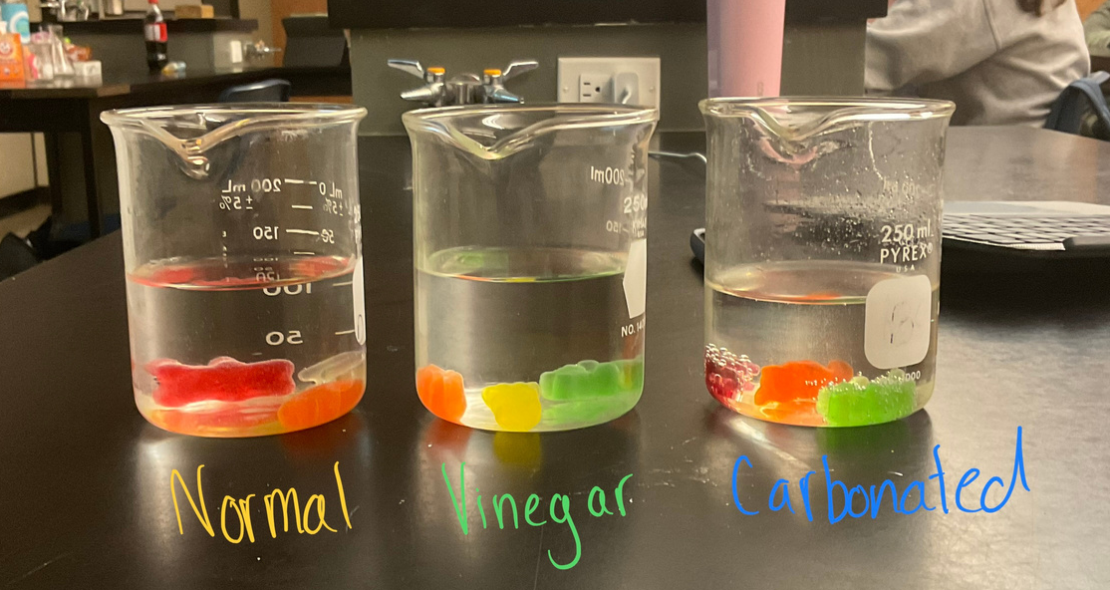
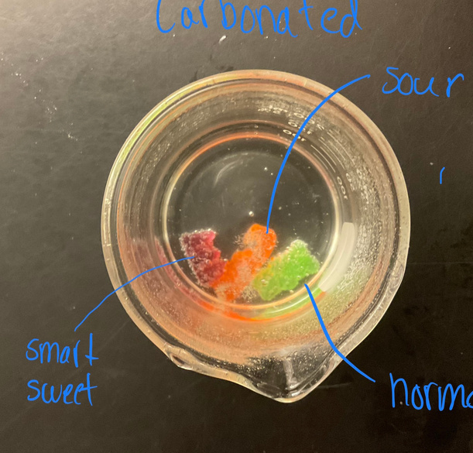
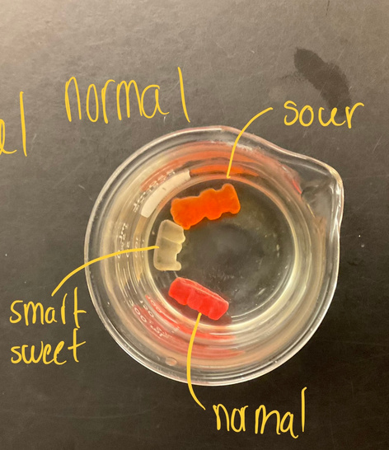
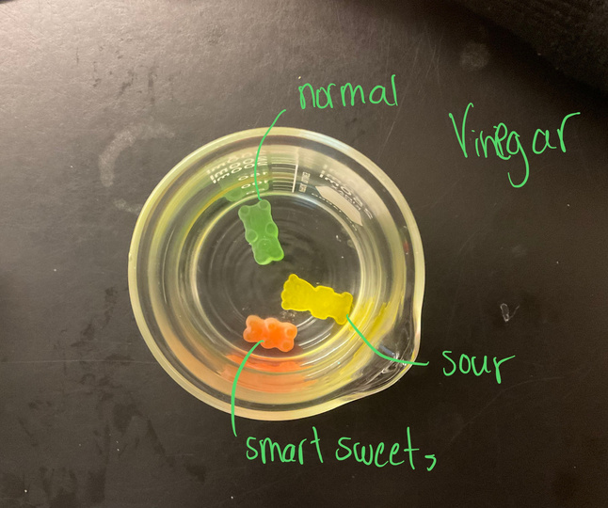
DAY 1
Normal and Smart Sweets
just looked like they were in water.
Sour Patch
sugar fell off and then looked normal
Smart Sweets
Day 1. Bubbling but not as much as sour
sour Patch
Day 1.Fizzing immediately , slowed down
Normal
Day 1.Bubbled
Smart Sweet (red)
Day 1. Sugar peeling off
Sour Patch (Orange)
Sour sugar gone gummy peeling
Normal (Yellow)
Day 1. Sugar peeling off

Slide 4
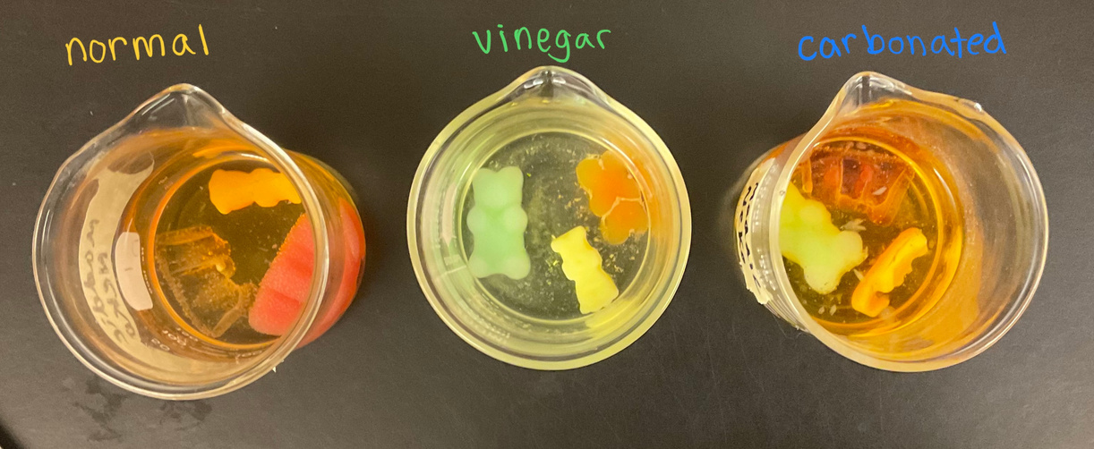
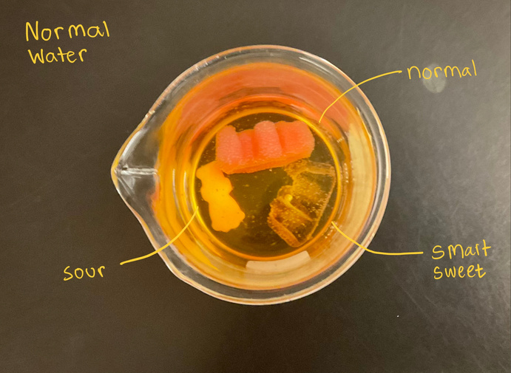
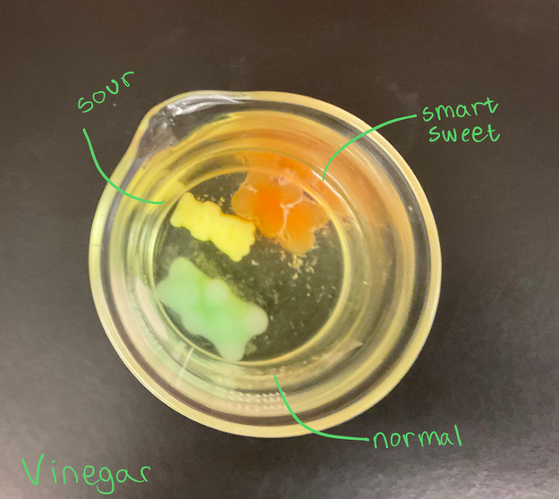
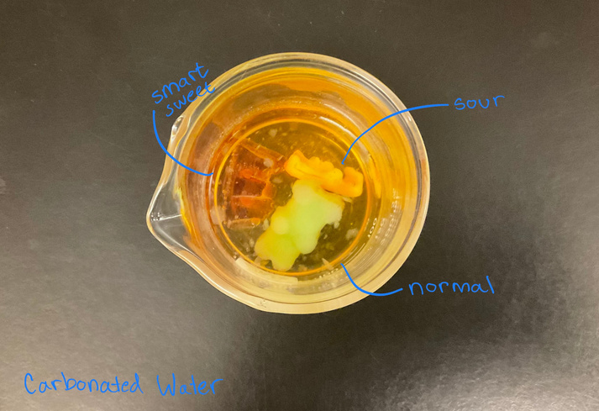
DAY 2
Normal Water
Normal- 3x1.5 cm, pink jiggly
Smart Sweets-translusent, two colours taller. 3.5x2 cm,
Sour -Same size loss of pigment and squishy
Vinegar
all same as normal water but Smart Sweets and Regular grew .2 cms less.Sour the exact same.
Carbonated Water
water had mild in it white in small circles.
Smart sweets reacted the same as did the normal. Sour disintegrated into tiny pieces. Unrecogdinizabe. Smart sweet and Normal mode jiggly than other liquids.

Slide 5
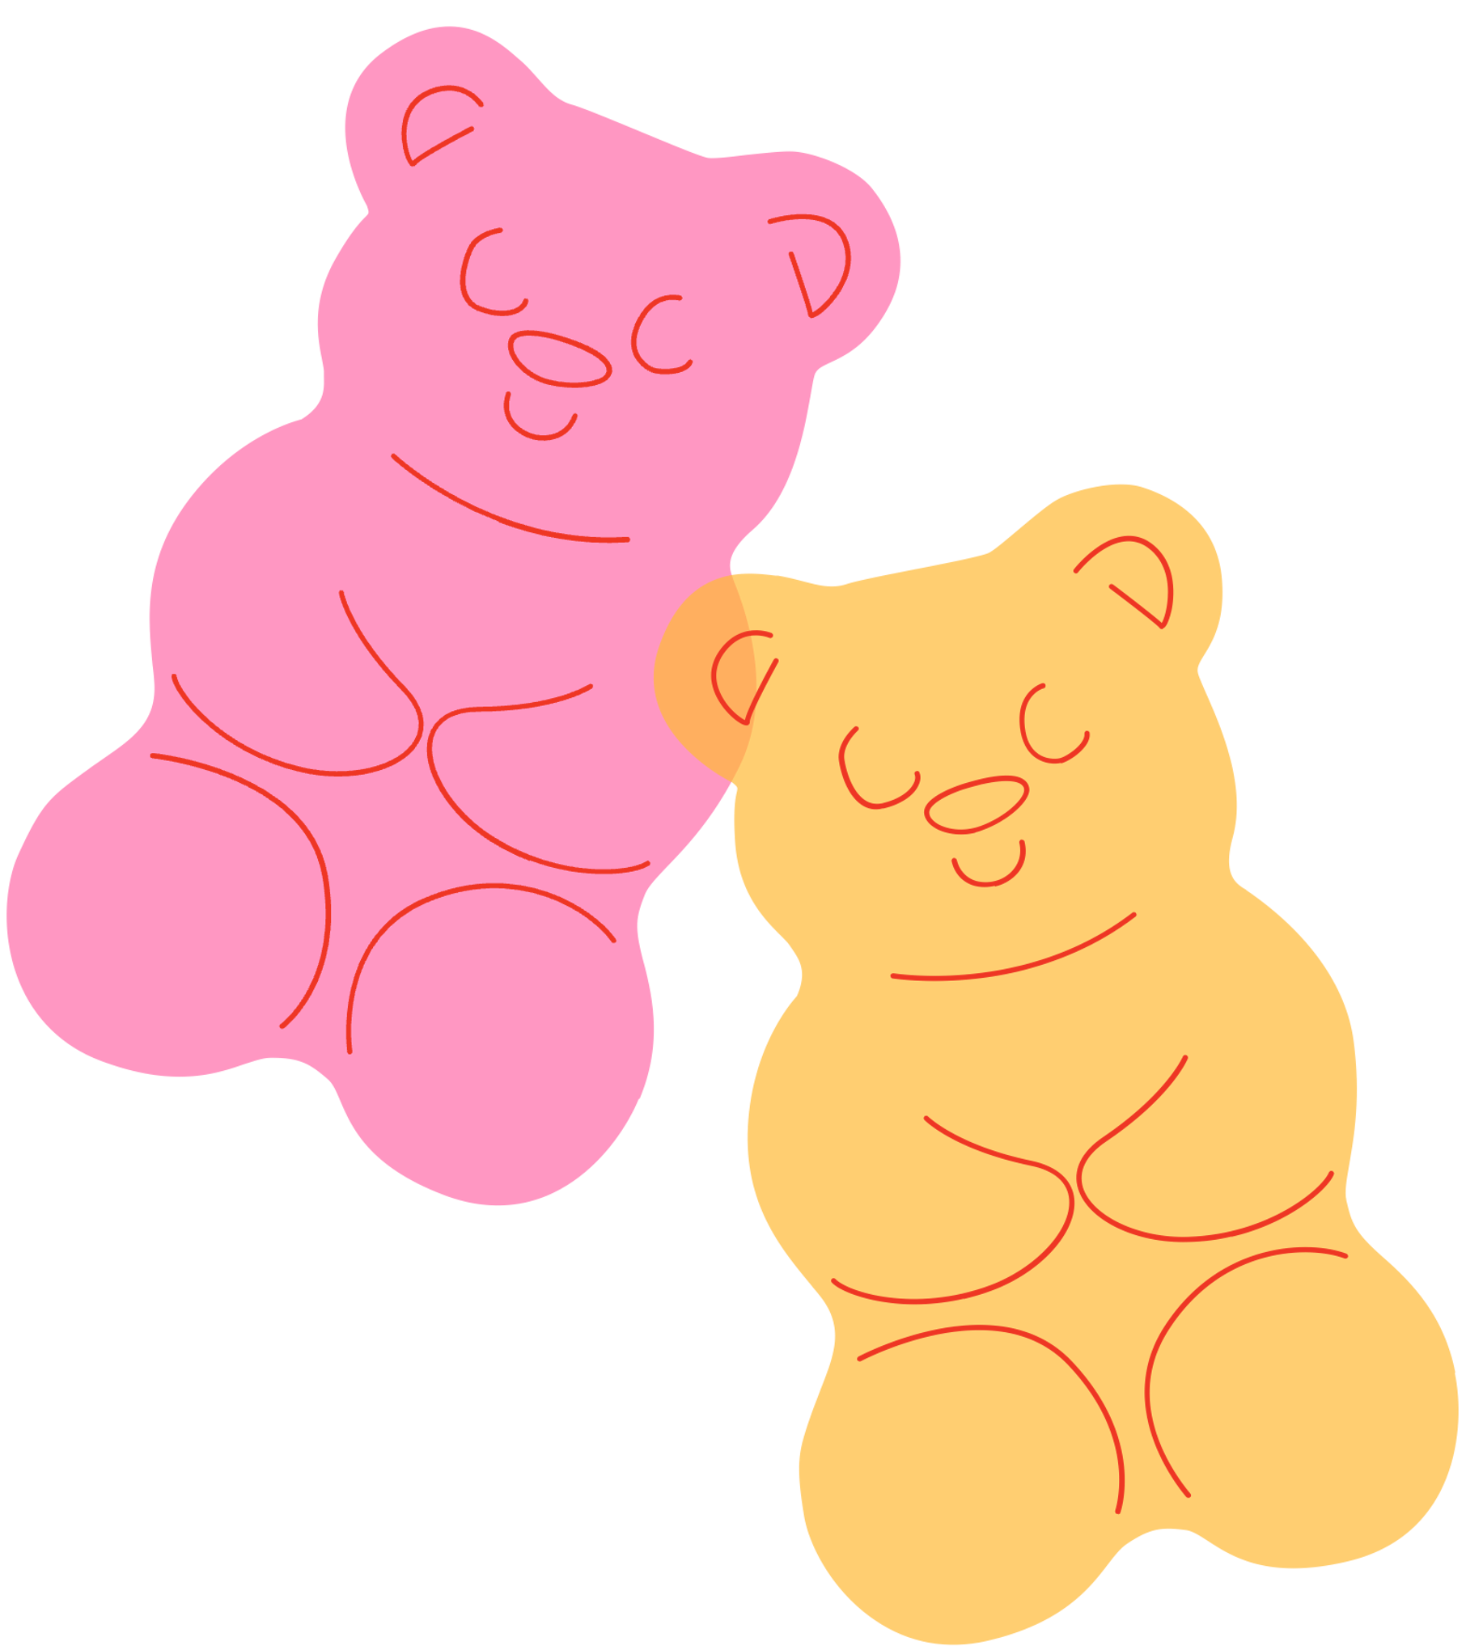
Research answer
Our research was to see how different brands would react to different liquids. The changes were already noticeable when we first placed the gummy bears in their beakers. All of the gummy bears had somewhat similar changes. They all grew in size and lost colour. The smart sweets all became clear and grew bigger, the sour patch kids all stayed the same size, and the normal gummy bears all grew in size.

Slide 6
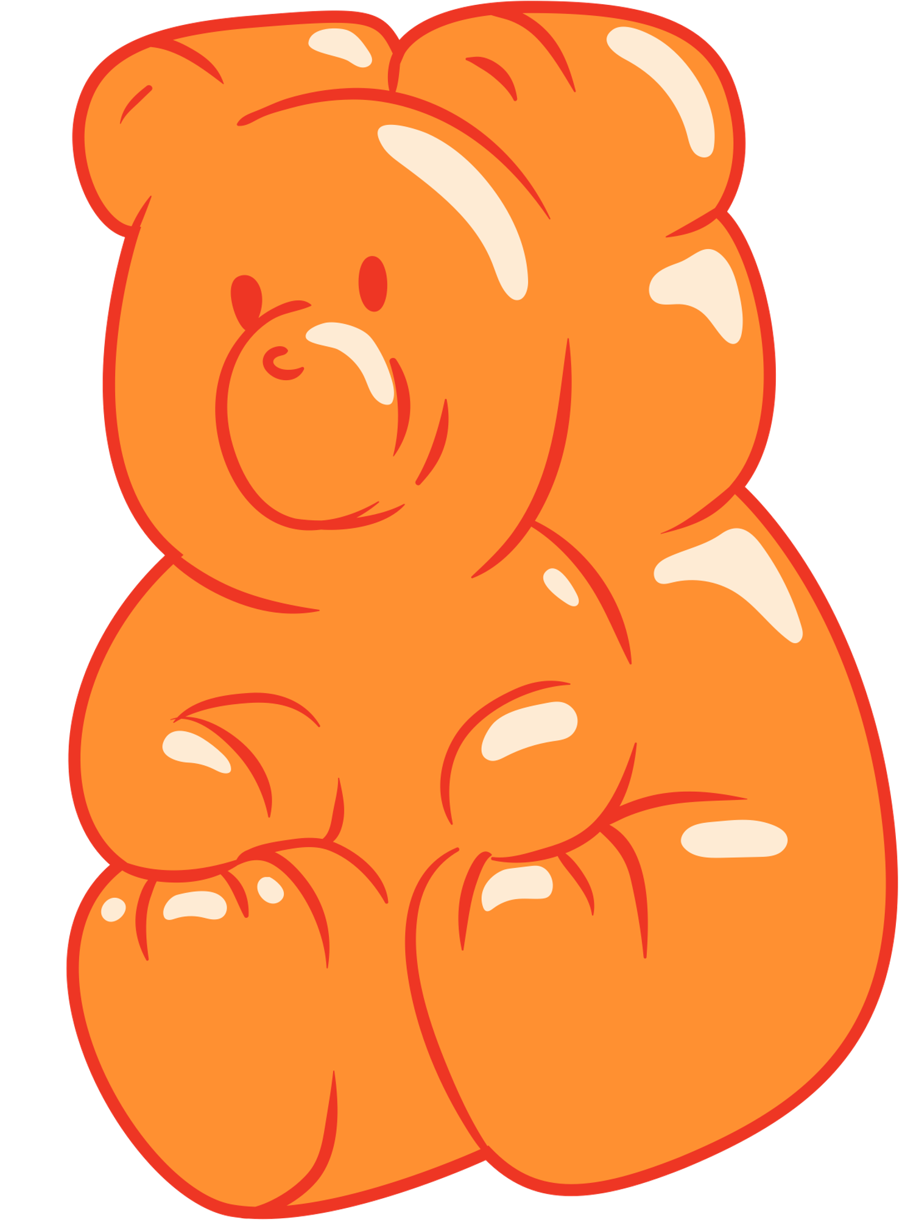
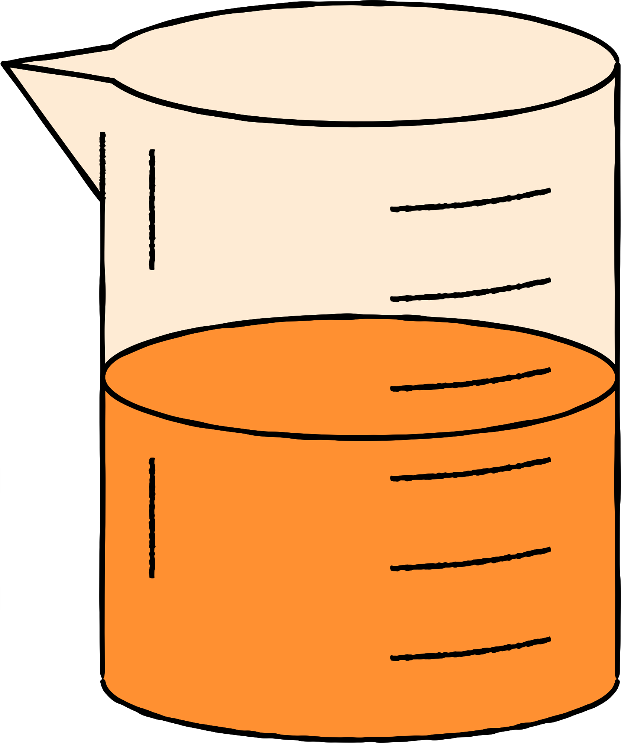
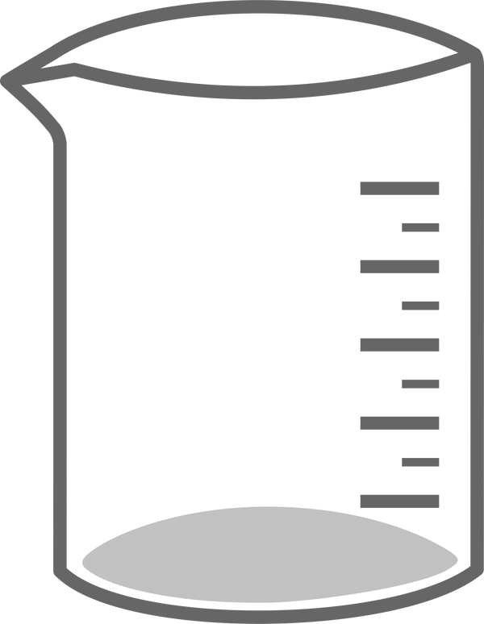
THANK YOU FOR LISTENING

